Slide 1
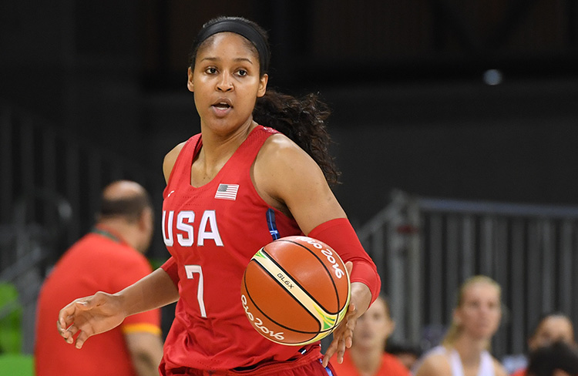
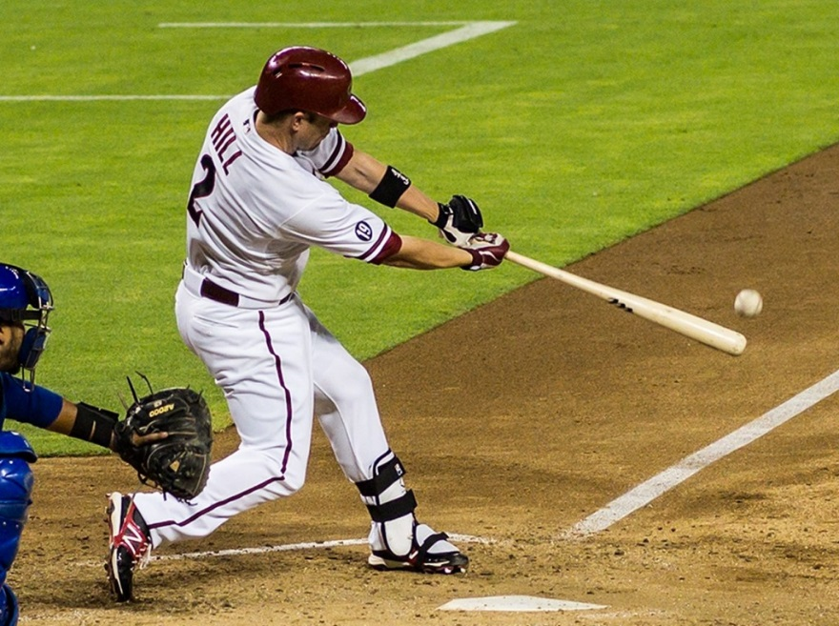
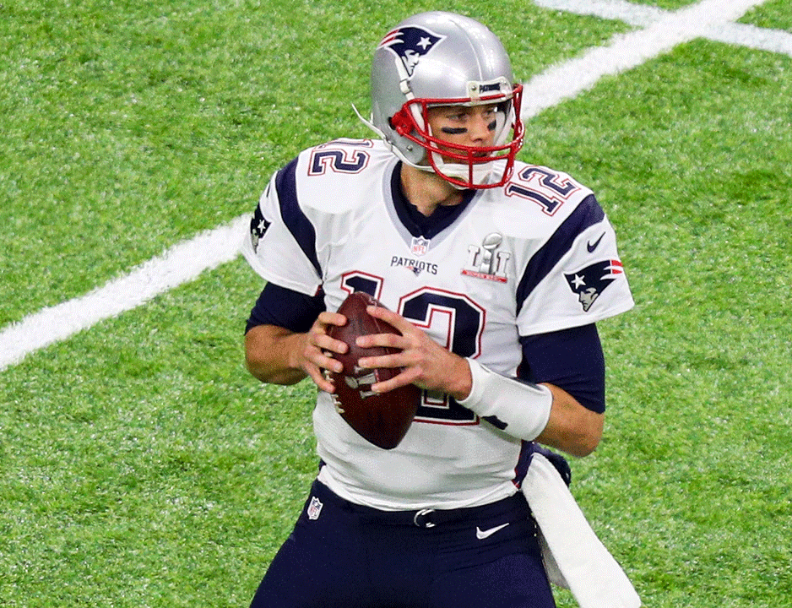
Basketball, Baseball, Football and Agile Teams @singhpr

Slide 2
Management, Leadership, Teamwork and High Performing Teams

Slide 3
Chickens!
Dr. William M. Muir, Professor of Animal Sciences at Purdue University.
Used a farm for experimentation where hens were kept in groups of 9 hens per cage.
Two versions of the Chicken Productivity Experiment
Select the best chickens from the farm and put them together to breed “Super Chickens”
Select the best overall performing cage and keep it intact and let them breed over time.

Slide 4
Results
Super-Chickens
Best Performing Cage
After a few days only 3 were alive.
The three that were left alive, had pecked at each other to assert dominance.
They were hyper-aggressive and in terrible shape.
Chickens were healthy.
Over multiple generation productivity improved.
After a few generations the cage of 9 was 160% more productive.

Slide 5
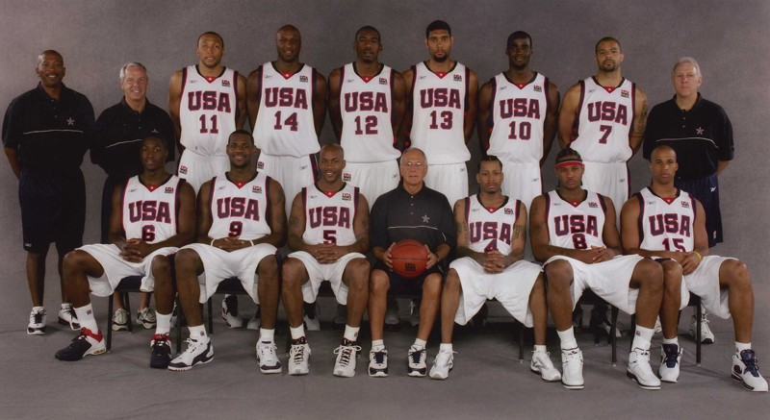
2004 USA Men’s Basketball Team

Slide 6
2004 USA Men’s Basketball Team
Lost the opening game to Puerto Rico (73-92).
Biggest loss in Olympic competition ever.
Also lost to Lithuania and Argentina.
Squeaked by Lithuania in the third place game to win the Bronze Medal.
What went wrong?

Slide 7
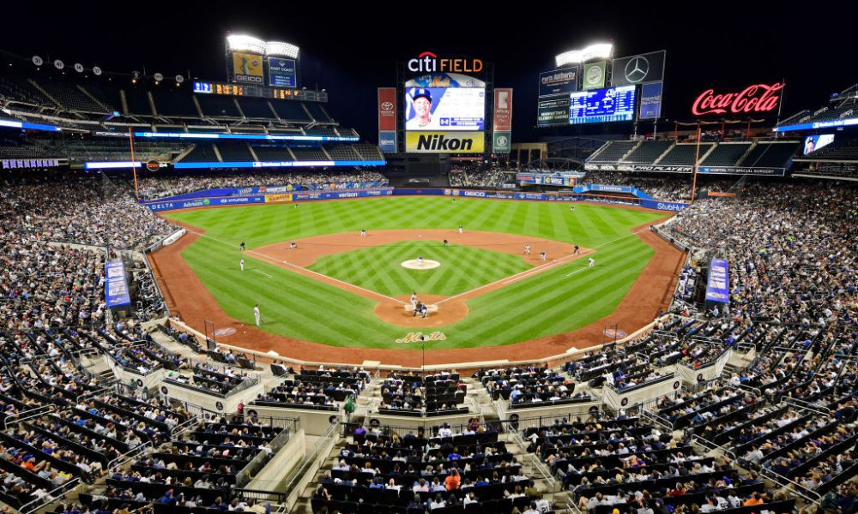
Baseball

Slide 8
What Effect Does Adding More Talent Have On A Team?
Combined study by scientists from Columbia University, INSEAD France and VU University Amsterdam in 2014.
They used WAR (Win Above Replacement) to rank players over a 10 year period (2004-2014).
They segmented the players into Top Talent (top 1/3rd) and the rest.
Team performance over the same 10 years was then compared for different levels of top talent on the team.

Slide 9
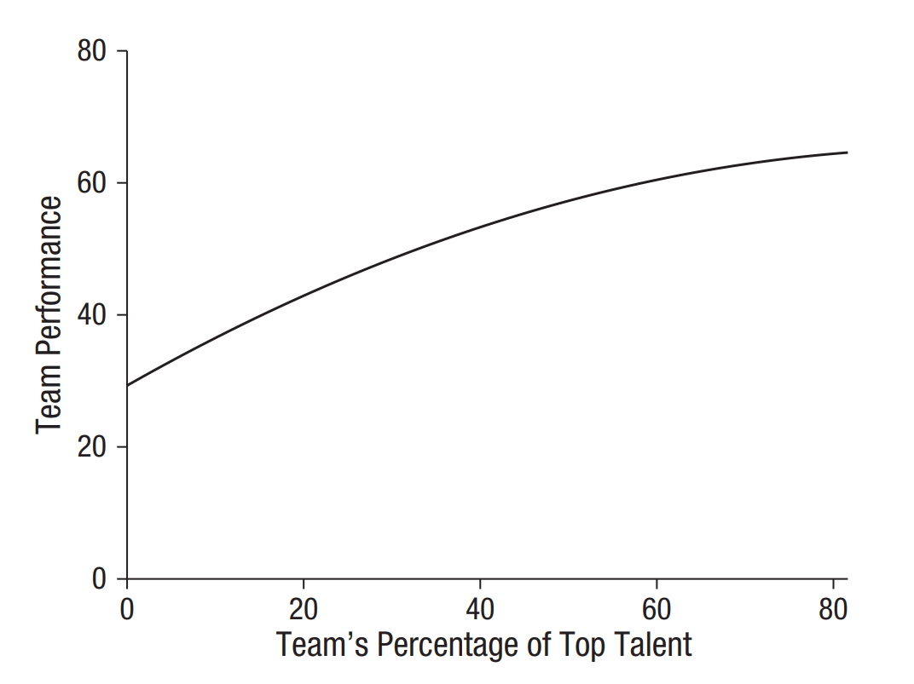

Slide 10

What About
Basketball?

Slide 11
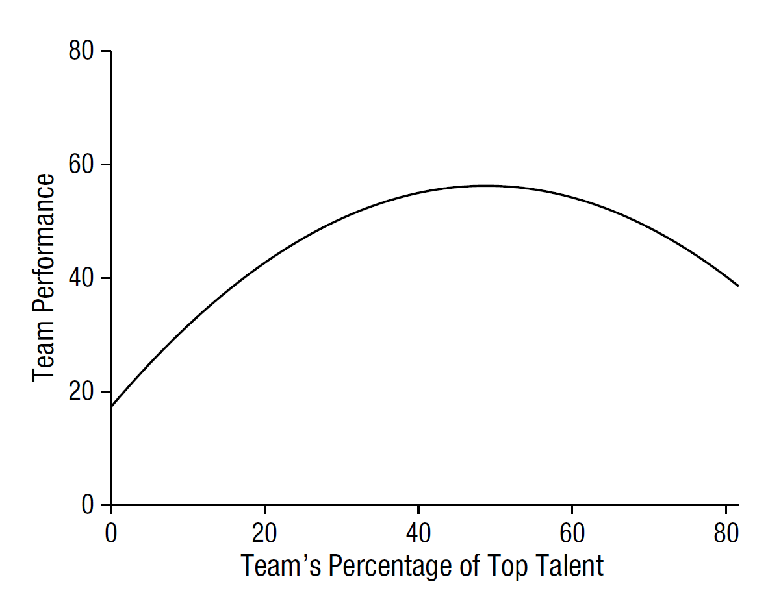

Slide 12
Why The Difference?
Baseball
Basketball

Slide 13
Why The Difference?
Baseball
Basketball
A great individual pitcher can guarantee wins in many games.
Need individuals with good batting averages.
Low task interdependence - every individual can be successful without depending on any other individual (mostly).
An individual sport masquerading as a team sport.
Need all players to perform to win games, great individual performances do not guarantee wins.
Need players who coordinate well with others on both offense and defense.
High task interdependence – winning strategies and tactics cannot be implemented without everyone being on the same page.
Much more of a team sport than an individual sport.

Slide 14
What Kind Of Team Is Yours?
Baseball or Basketball?
Is there very little interdependence when it comes to getting things done?
Do team members work together to accomplish goals?
Is team performance more important or individual performance?
What about Agile teams?

Slide 15
Waterfall
Analysis
Development
Test
Deployed
4
1
5
2
6
3
7
8
9

Slide 16
Waterfall
Analysis
Development
Test
Deployed
4
1
5
2
6
3
7
8
9

Slide 17
Waterfall
Analysis
Development
Test
Deployed
4
1
5
2
6
3
7
8
9

Slide 18
Agile (Scrum)
Backlog
This Iteration
Deployed
4
1
5
2
6
3
7
8
9

Slide 19
Baseball Management For Basketball Teams
We have moved to a more team based culture (Agile).
Unfortunately our management practices are individual based.
Hiring, Rewarding, Recognizing, Firing, Promoting etc. are all centered around the quest for “Super Chickens”.
Successful team based culture requires team based management.

Slide 20

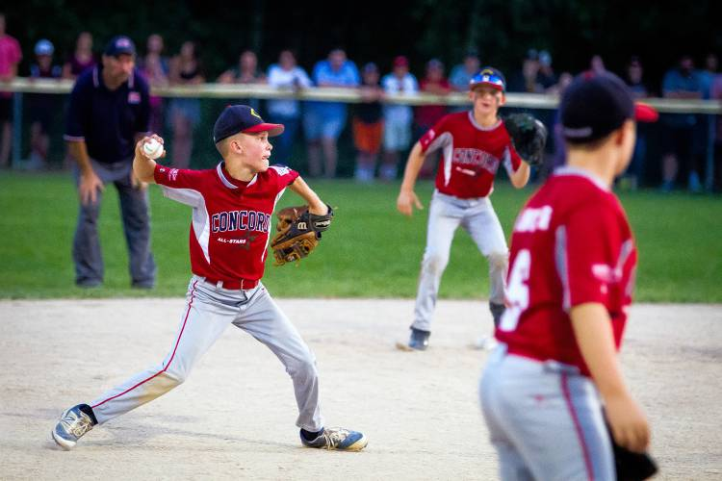

Infatuation With Individual Brilliance

Slide 21
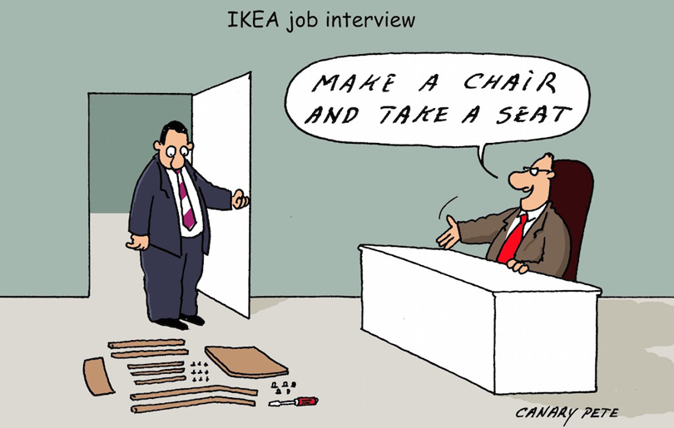

Slide 22
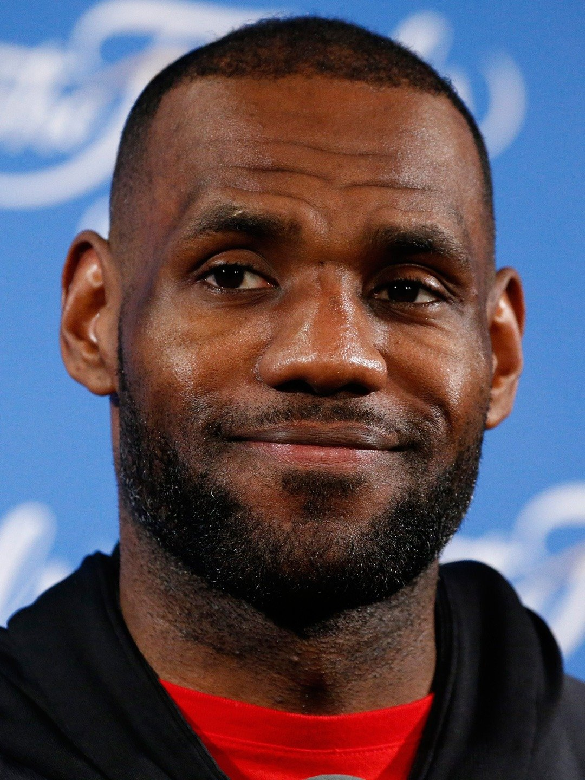

Slide 23
How many folks work on/with agile teams?
How many folks have individual performance goals?
Whose organization hands out “All-Star” or “MVP” type awards?
Are “Heroes” rewarded/recognized/revered?
What are majority of your interview questions focused on (Technical Ability or Culture Fit)?
Who gets promoted?

Slide 24
We Have
Designed
Management Practices
And
Social Constructs
That Encourage
People To
Act Like
Super Chickens

Slide 25
Managing High-Performing Teams
Manage Agile Teams Like Basketball Teams – Placing Team Performance Over Individual Performance.
Abolish Individual Awards.
Set Team Goals (and only team goals).
Hire /Promote Team Players, not “Super Chickens”.
Promote Social Interaction Through Team Activities, Synchronized Breaks, Open Floor Plans.
Safety, Vulnerability, Direction.

Slide 26
The Culture Code – Daniel Coyle
The Three Rules of High Performing Organization -
Safety – Everyone feels safe to voice opinions and disagree.
Vulnerability – Everyone feels comfortable to say “I don’t know” or “I cannot accomplish this” or “I messed this up”.
Direction – They have a combined clear team/organizational goal and understand the “Why”.
Google’s Project Aristotle Found The Same Results.

Slide 27
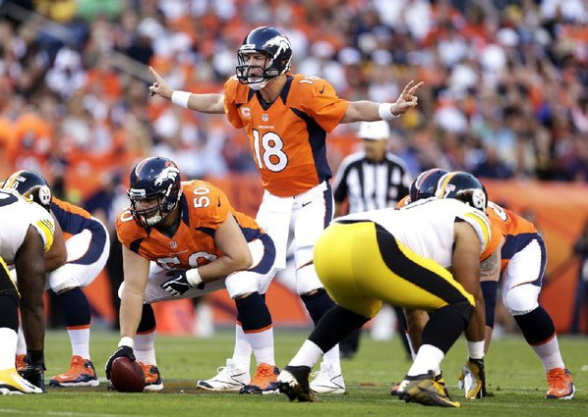
Redefining Superstars

Slide 28
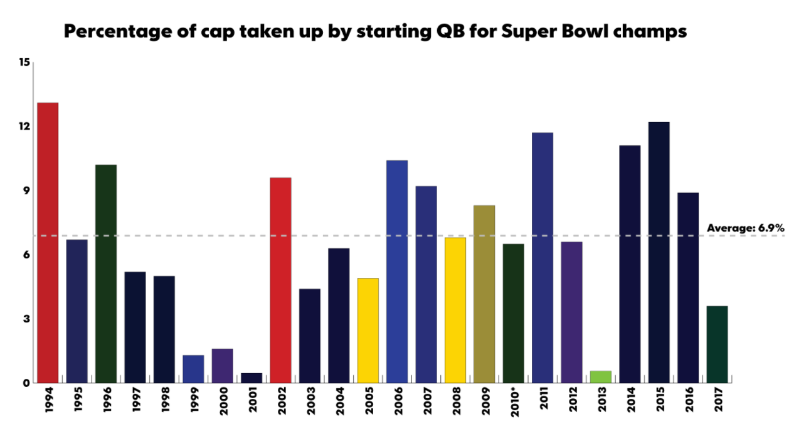
10%

Slide 29
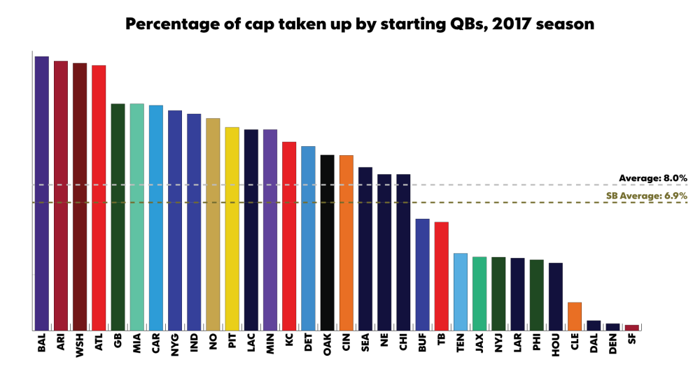
10%

Slide 30
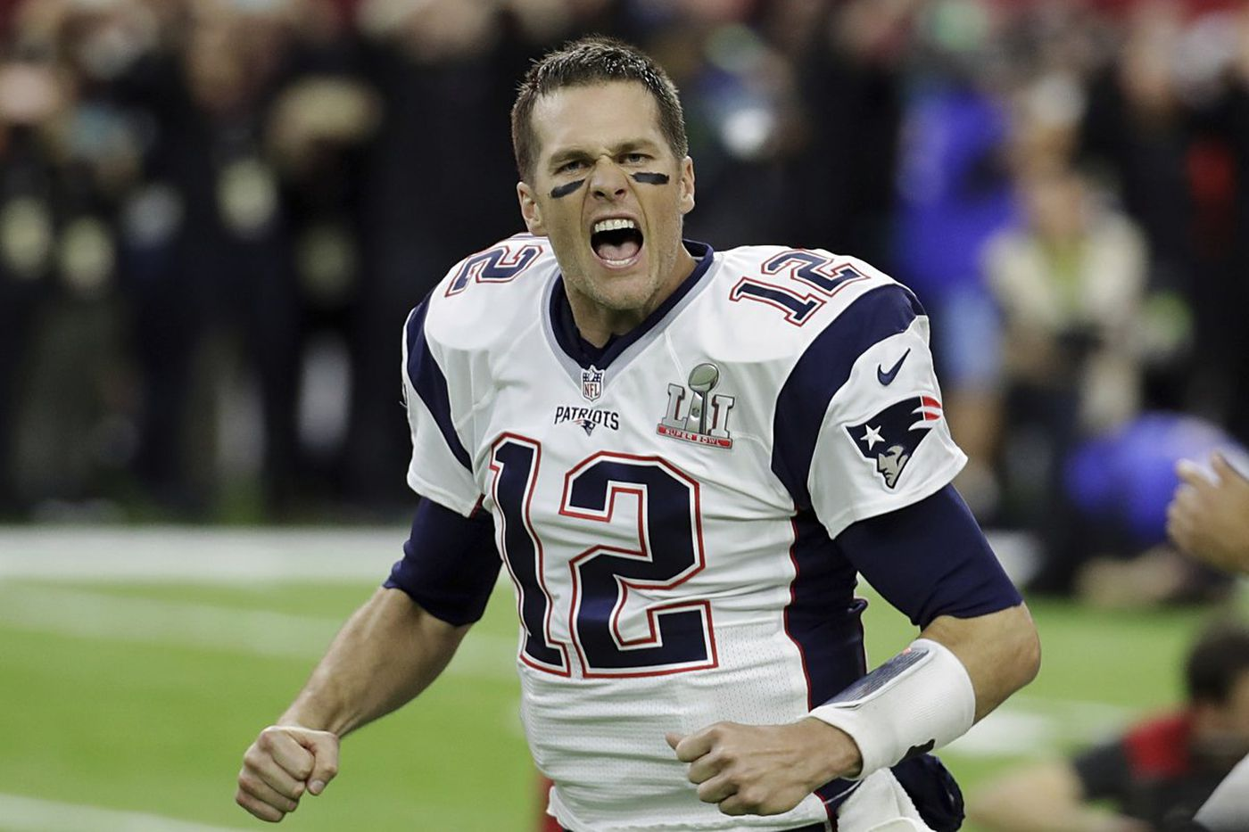
2011: 8th
2012: 17th
2013: 5th
2014: 12th
2015: 14th
2016: 18th
2017: 20th

Slide 31
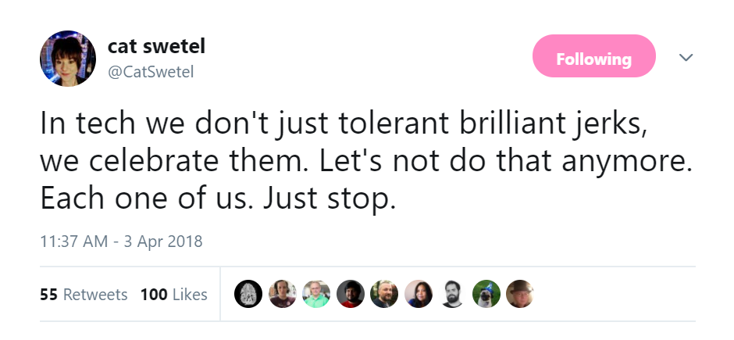
We Have A “Brilliant Jerks” Problem

Slide 32
“Super Chickens” & “Brilliant Jerks”
Safety
Vulnerability
Direction

Slide 33
MIT Sloan
700 Participants broken up into groups of 2 to 5 people and assigned variety of tasks.
Success had no correlation with the average IQ of the group
Success had no correlation with the maximum IQ of the group members.

Slide 34
MIT Sloan
Three factors that correlated to success –
Average social sensitivity of group members
Equality in distribution of conversational turn-taking
Proportion of females in the group

Slide 35
Definition Of Agile
Work in Small Batches
Limit Work in Progress
Get Feedback
Do Not Sabotage Your Ability to Do the First Three Points

Slide 36
Redefine Who Your Superstars Are
Folks who propel the team, as a whole, forward.
Team members that make everyone else’s life easier (without sacrificing their own).
Folks who promote high performing team characteristics -
Safety
Vulnerability
Direction

Slide 37
2008 USA Men’s Basketball Team
Coach Larry Brown was replaced by Duke's Mike Krzyzewski.
“Truth be told, that's probably why nine guys decided that they didn't want to go do the (2004) Olympics.“
NBC Sports' Bill Leopold and Ben Teitelbaum
Players were not invited to the Olympic team, instead they were invited to a 3-year National Team Program.
LeBron, Wade and Kobe became vocal team leaders, instead of individual superstars.

Slide 38
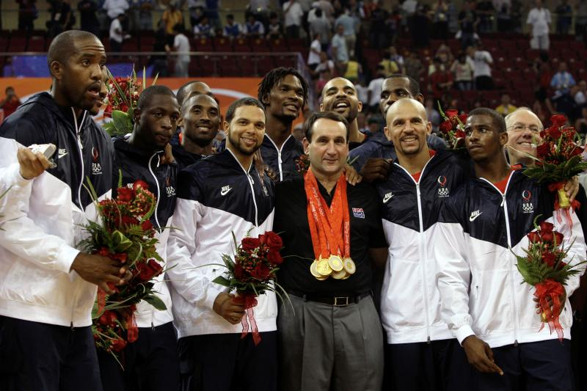

Slide 39
Help Your
“Super Chickens”
Become
Team Players
In Most Cases,
They Want
To Help

Slide 40
Denounce
“Brilliant Jerks”
In Favour
Of
Team Players

Slide 41
Breed
A
Team Culture
Instead
Of
Super Chickens

Slide 42
Manage
For
Basketball Teams
Not
Baseball Teams
(unless that is what you want)

Slide 43
“What matters is the mortar,
not just the bricks.”
– Margaret Heffernan

Slide 44
References
Margaret Heffernan's Ted Talk – Forget The Pecking Order
MIT Sloan – What Makes Teams Smart (Woodley et al)
Daniel Coyle – The Culture Code
The too-much-talent effect: Team interdependence determines when more talent is too much versus not enough. - Swaab, R. I., Schaerer, M., Anicich, E. M., Ronay, R., & Galinsky, A. D.
ESPN, Bleacher Report, Over The Cap, SBNation

Slide 45
Thank You
@Singhpr

